Slide 1
Digital Portfolio
STUDENT NAME: S.SIVASANKARAN
REGISTER NO : 24134121802521032
NMID:autanm41241224ucsc014
DEPARTMENT: B.SC COMPUTER SCIENCE
COLLEGE: KALAIMAHAL COLLEGE OF ARTS AND SCIENCE
UNIVERSITY: ANNAMALAI

Slide 2
PROJECT TITLE
Digital portfolio :
*Showcasing my journey of learning and
creating.
*A portfolio that reflects my skills and
passion.
*Turning ideas into projects with code.
*My work, my growth, my portfolio.
*Learning, building, and improving every day.

Slide 3


AGENDA
Problem Statement
Project Overview
End Users
Tools and Technologies
Portfolio design and Layout
Features and Functionality
Results and Screenshots
Conclusion
Github Link
3/21/2024 Annual Review

Slide 4

PROBLEM STATEMENT
*Many students and professionals struggle to showcase their skills, projects, and achievements in a structured way. A personal portfolio website is required to provide an online platform where individual can present their profile, skills, projects, and contact information in a clean and interactive manner. *This portfolio website should be built using HTML, CSS, and JavaScript, ensuring it is simple, user-friendly, and visually appealin

Slide 5

PROJECT OVERVIEW
This project is a personal portfolio website created using HTML, CSS, and JavaScript. It showcases my profile, skills, and projects in a clean and responsive design. The website helps me present my work online in an interactive way, with sections like About, Projects, and Contact for easy navigation.

Slide 6

WHO ARE THE END USERS?
*Students & Classmates – who want to know about my skills and projects. *Teachers & Evaluators – for academic project review and assessment. *Recruiters & Companies – to check my portfolio for job or internship opportunities. *General Visitors – anyone who wants to view my profile and contact me.

Slide 7

TOOLS AND TECHNIQUES
>>HTML5 – to create the structure of the portfolio. >>CSS3 – to style the website and make it visually attractive. >>JavaScript – to add interactivity (typing effect, animations). >>CodePen – as the online code editor and testing platform. >>Web Browser – to run and view the portfolio website.

Slide 8
POTFOLIO DESIGN AND LAYOUT
>>Header Section – Shows your name, tagline, and typing effect. >>About Section – Brief introduction about yourself and skills. >>Projects Section – Displays your projects in card style with titles and short descriptions. >>Contact Section – Contains email, phone, or social media links for communication. >>Footer Section – Simple footer with © copyright info.
8

Slide 9
FEATURES AND FUNCTIONALITY
Features Typing animation in header for attractive look. Responsive design (fits desktop & mobile). Project showcase with cards. Contact section with email/social links. Functionality Header → Displays name, tagline, and typing effect. About → Gives introduction and skill details. Projects → Shows project list with short descriptions. Contact → Allows users to reach via email or links. Footer → Displays © copyright information.

Slide 10
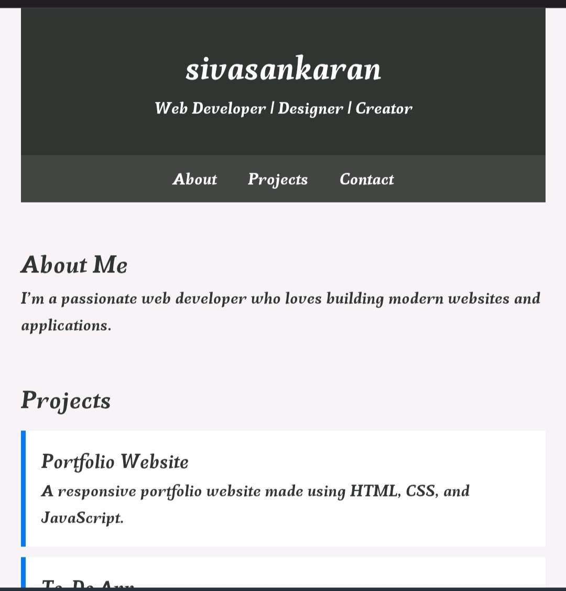
RESULTS AND SCREENSHOTS
A fully working personal portfolio website was successfully developed using HTML, CSS, and JavaScript. The website displays my profile, skills, and projects in a clean and organized way. The typing animation in the header makes the design more interactive. Users can easily navigate through About, Projects, and Contact sections. The portfolio helps to showcase my work to teachers, classmates, and recruiters online.
3/21/2024 Annual Review
10

Slide 11
CONCLUSION
The portfolio website was successfully created using HTML, CSS, and JavaScript. It provides an easy way to showcase my skills, projects, and contact details in a structured manner. This project improves my web development knowledge and helps me present myself professionally to teachers, peers, and recruiters.
11

